Slide 1

19ECE204 DIGITAL ELECTRONICS AND SYSTEMS L-T-P-C: 3-1-0-4

Slide 2
Course Objectives
• To understand the fundamentals of Boolean Logic and the building blocks of digital circuits
• To introduce the abstraction of simple practical problems into Boolean Logic and their efficient implementation
• To introduce the fundamentals of design with combinational and sequential subsystems
Course Outcomes
CO1: Able to frame Boolean equations for solving a simple real-life engineering problem and realize them using gate-level building blocks
CO2: Able to apply minimization techniques for efficient Boolean logic implementation
CO3: Able to realize digital blocks using combinational and sequential subsystems
CO4: Able to design using state machine descriptions for practical real-life engineering problems

Slide 3
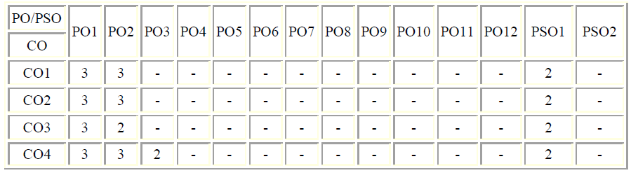
CO – PO Mapping
TEXT BOOK:
Stephen Brown, Zvonko Vranesic, “Fundamentals of Digital logic with Verilog Design”, Tata McGraw Hill Publishing Company Limited, Special Indian Edition, 2007

Slide 4
REFERENCES:
1. Morris Mano, “Digital Design”, Pearson Education, Third Edition.
2. Donald D Givone, “Digital Principles and Design”, Tata McGraw Hill Publishing Company Limited, 2003.
3. Allen Dewey, “Analysis and Design of Digital Systems with VHDL”, PWS Publishing Company, 1999.
4. John F. Wakerly, “Digital Design Principles and Practices”, Pearson Education, 3rd Ed, 2001.

Slide 5
EVALUATION PATTERN
Quiz – 25 marks
Tutorial - 15 marks
Home Assignments – 15 marks
Mid Term Test – 15 marks
End Semester Online Examination – 15 marks
End Semester Viva - 15 marks

Slide 6
Note:
The quizzes will comprise MCQ and fill in the blank questions for 30 minutes duration. Each quiz will be for 10 marks and will comprise 5 Fill in the Blanks questions and 5 MCQ questions.
The tutorials will be 30 min and consist of word problems (3 problems). The total marks for each tutorial test will be 15 (5 marks for each question). The students have to write down the solutions with steps, scan the answer sheet and upload the PDF to AUMS/AMPLE
Home assignments will comprise 10-15 problems related to the topics covered.
Mid Term Test and End Semester Online exam will have a mix of short-answer questions and descriptive problems

Slide 7

Why Digital?
This course is about circuits known as logic circuits that make the computer.
A logic circuit is a circuit in which the signals are constrained to have only some number of discrete values.
Logic circuits are used to build hardware for computer, smart phones, smart TVs and other types of products.
These products are broadly classified as digital hardware.
The name digital derives from the fact that, the information in the form of electronic signals in these devices are represented as digits.

Slide 8


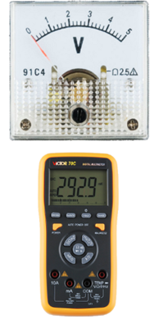


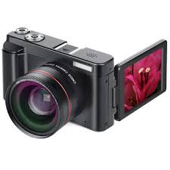


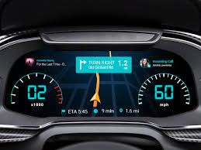
Analog vs Digital Devices

Slide 9
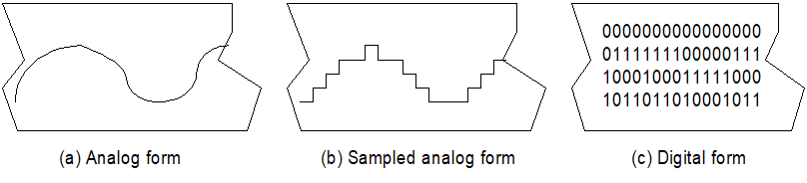
Analog vs. Digital Signals
Analog vs. Digital: Continuous vs. discrete.
Real world signals are Analog.
Sound, Temperature , Pressure
But analog signals are easily corrupted while processing and transmitting like
Distortion of amplitude, frequency or phase
External noise due to Electromagnetic interference
Internal noise due to components in the system

Slide 10
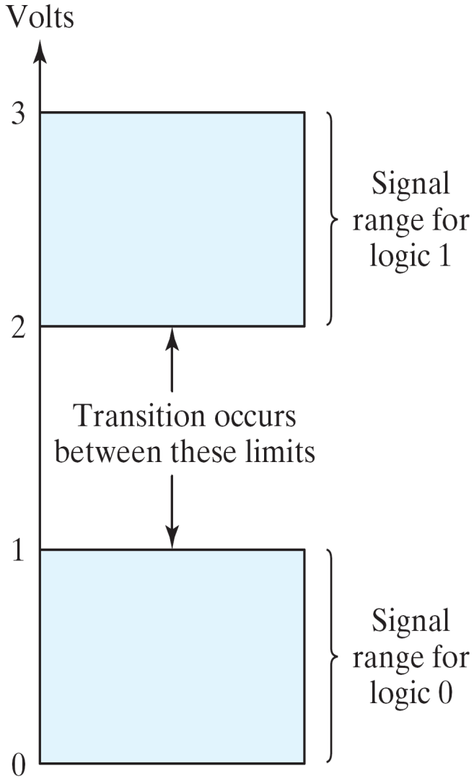
Binary Digital signal
Example of binary signals
3
Logic 1
2
Un-define
1
Logic 0
0

Slide 11
Digital Systems - Advantages
Noise immunity
Power of abstraction
Digital signals are processed by digital gates (AND, OR, NOT, NAND, NOR etc.)
Modular designs possible
Knowledge of Internal circuit implementation is unimportant
Faster design completion
Ease of automation through software (Electronic Design of Automation (EDA) tools)

Slide 12
Contd.
Programmability
The hardware can be used for various tasks by a software
Miniaturization
As the size of transistor is getting smaller, more of them can be built on a chip leading to smarter systems on smaller chips

Slide 13
Digital Systems - Design Hierarchy
System level - Register level - Gate level - Transistor and physical design level
System level: Black box specification.
Register level: Collection of registers.

Slide 14
Contd.
Gate level: Collection of logic gates.
Transistor and Physical design level: Each logic gate is implemented by a lower-level transistor circuit.

